Slide 1
Introduction to Machine Learning
RS School 2021Q1

Slide 2
Who are we and what we are doing
Group of enthusiasts from Data Science team in Minsk, Belarus
A large number of successfully completed projects in various fields
Vladislav Poritskiy
Dmitrii Petukhov
Yuliya Malakhouskaya
Lizaveta Dauhilava
Dmitry Kurch
Ivan Kravchenko
Yaraslau Kiryllau
Kiryl Yematsinau

Slide 3
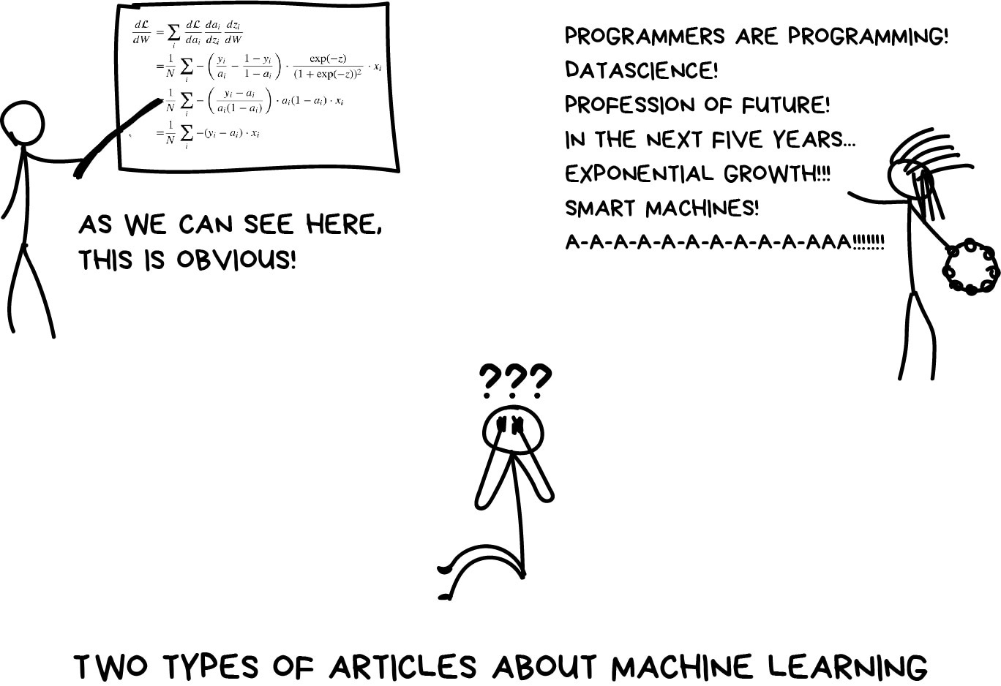
What is Machine Learning

Slide 4
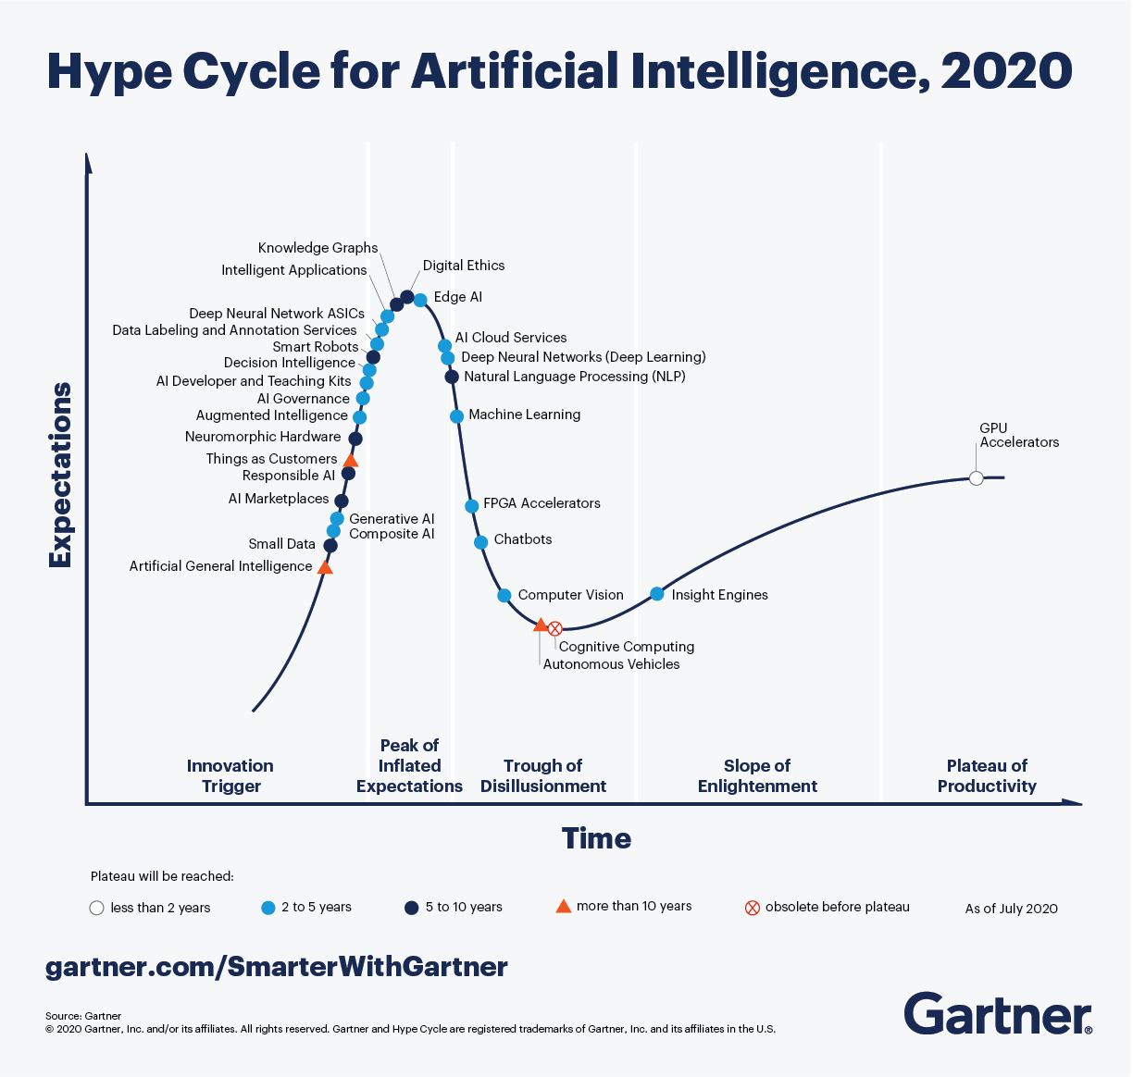
Gartner Hype cycle for Artificial Intelligence
In 2012, Harvard Business Review dubbed Data Scientist the sexiest job of the 21st Century.

Slide 5
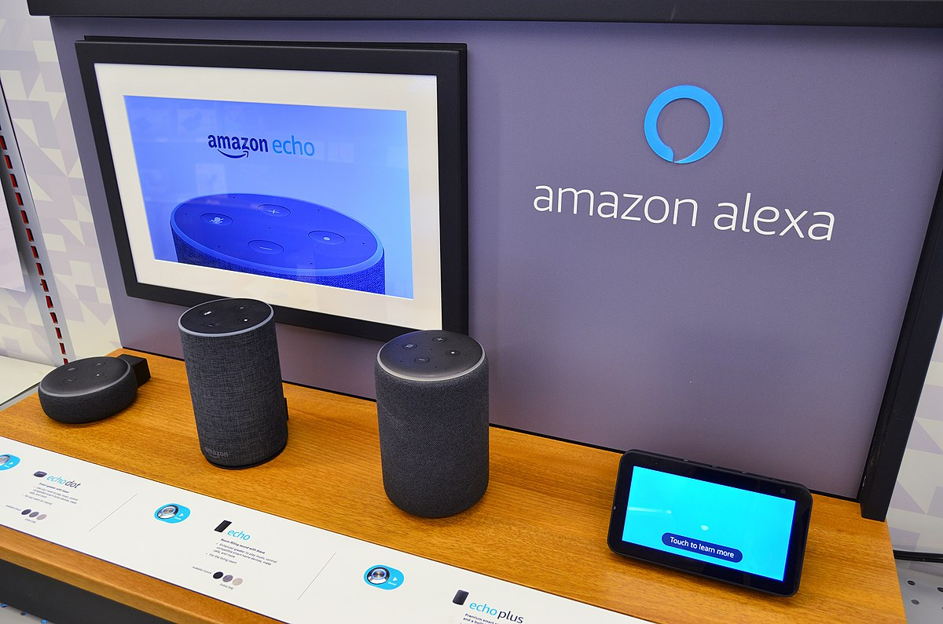
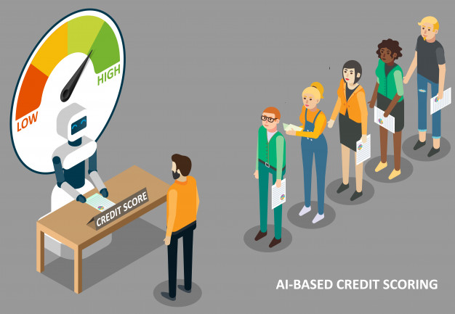
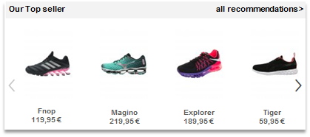

ML is everywhere!
Virtual Personal assistance
Product recommendations
Credit scoring
Car price prediction

Slide 6

Course goal
Shape the concept of what machine learning is
Enable the student to acquire basic ML competence for further independent study and research
Prepare the student for applying ML to real-world problems and use it in practice (including Capstone project)

Slide 7
Prerequisites
https://github.com/rolling-scopes-school/ml-intro/tree/2021/0_prerequisites
Python basics (Fundamentals, Strings, Arrays, Regular Expressions, OOP)
Linear Algebra basics (operations on vectors, matrices; norms, distances)
Probability theory and statistics (random variable, variance, expected value, correlation).

Slide 8
Course structure
Program overview:
Introductory lecture
8 modules, one per week
Capstone project
Necessary links:
Course Git https://github.com/rolling-scopes-school/ml-intro
Course Discord server https://discord.gg/c2dzBeMyVA
Course RS APP registration https://app.rs.school/registry/student?course=ML-intro-2021Q1
RS School documentation https://docs.rs.school/#/README

Slide 9
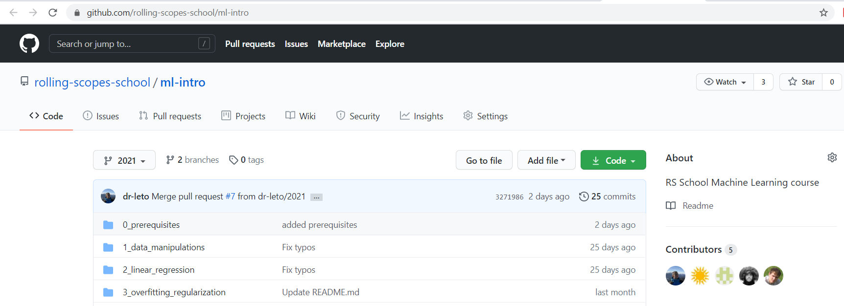
Course GitHub
Used for sharing all up-to-date course materials including assignments, lectures, links to books and papers, tests and etc.
Do not forget to fetch changes regularly – repo is constantly updated!
Feel free to create an issue / pull request if you see fit, instruction https://docs.rs.school/#/fix-typo

Slide 10
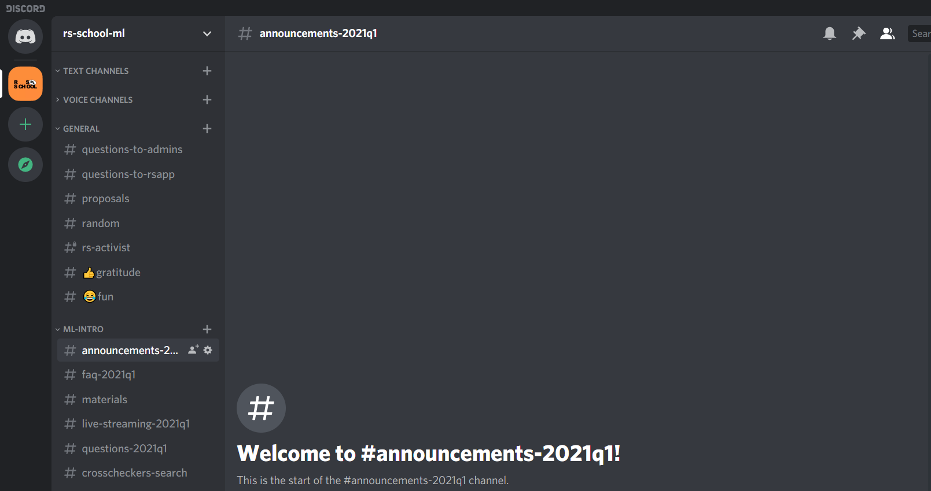
Course Discord server
Used for any type of communication: formal, informal, random, questions. Just try to adhere to the elementary rules of decency and choose the appropriate channel.
All the necessary information on the current module, assignments and deadlines is posted in announcements-2021q1

Slide 11
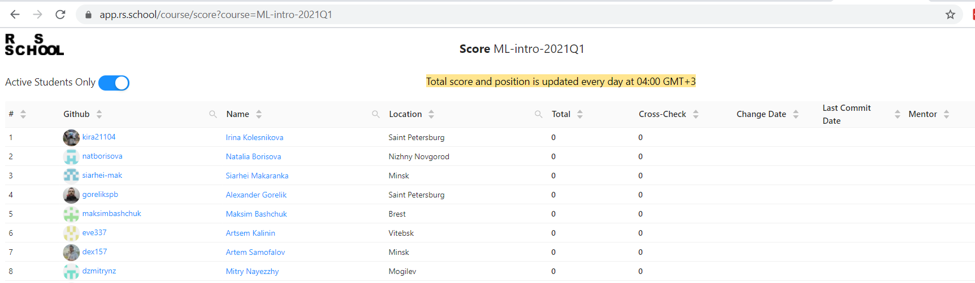
Course RS APP
Here you can find you scores, submit tasks for automatic verification and cross-checks

Slide 12
Course rules
Hard deadlines for assignments
Cross-check and automatic check of assignments
No cheating
Code of conduct https://docs.rs.school/#/code-of-conduct

